Slide 1

RoomNinja
Gobind Morya, 12000756

Slide 2

Aim
Drawback of Existing System
Project Explanation
Modules
Requirements
Advantages of Project
DFDs
Technology Used
RequirementsScreenshots
Conclusion
Future Scope
Thank you

Slide 3
Drawback of Existing System
Incomplete or Outdated Information:
Lack of comprehensive and up-to-date information about available PG accommodations.
Insufficient Interaction and Communication:
Users may face difficulties in scheduling visits or asking questions about the accommodations.
Inadequate Customer Support:
Limited availability of customer support or assistance for users.

Slide 4
Project Explanation
RoomNinja is a PG search web app online platform, specifically designed to help users search and find Paying Guest accommodations or shared living spaces.
User-friendly interface accessible via web browsers.
Online booking functionality for convenient reservation.
Convenience in comparing different PG accommodations.

Slide 5

Modules
Admin Panel
Website/ User Panel

Slide 6

Admin - Functionalities
Login
Manage Category
Manage Products
Manage Users/ Customers
Manage Booking Status
Respond to Enquiry
Logout

Slide 7

Customer - Functionalities
Register
Login
View PG
Filter PG according to Location
Booking PG
View Booking Status
Logout

Slide 8
Requirements
Hardware Requirements
Processor : i3
RAM : 8 GB
SSD : 256GB
Software Requirements
Front End : HTML, CSS, Bootstrap, JavaScript, ECMA Script, React JS
DB Tool : Firestore
Browser : Mozilla Firefox/Chrome/ Edge
OS : Windows Operating System/Linux
Text Editor : Visual Studio Code
Environment : Firebase

Slide 9

Advantages
Our PG-searching platform will increase the productivity of the business since it expands the scalability.
There is no limit of location range and customers are no longer visiting the PG physically.

Slide 10

Data Flow Diagram

Slide 11
DFD Diagram Level 0
RoomNinja
Admin
User

Slide 12
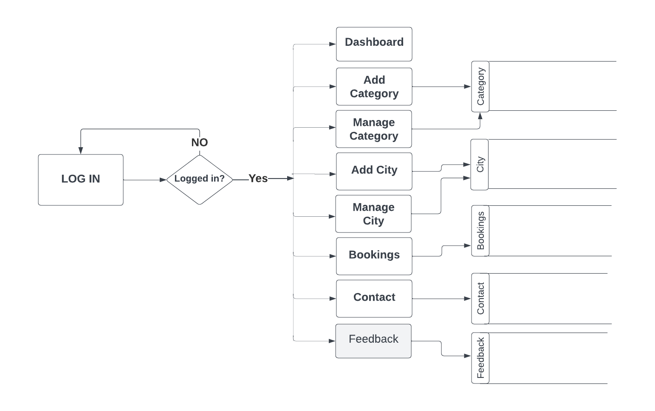
DFD Diagram of Admin

Slide 13
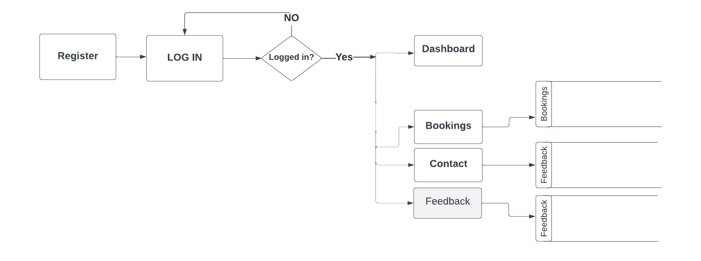
DFD Diagram of User

Slide 14

Technology Used

Slide 15
Front End Technology
HTML
CSS
JAVASCRIPT
ECMASCRIPT
BOOTSTRAP
REACT.JS

Slide 16
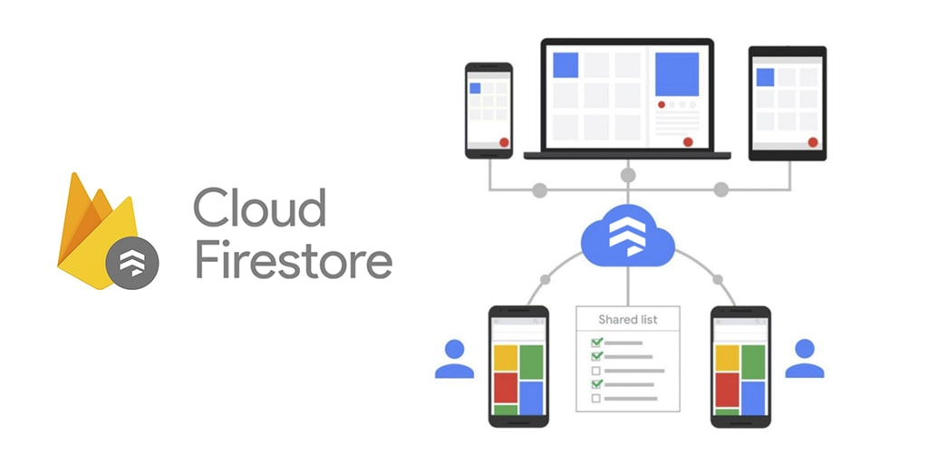

Back End Technology

Slide 17

Screenshots

Slide 18
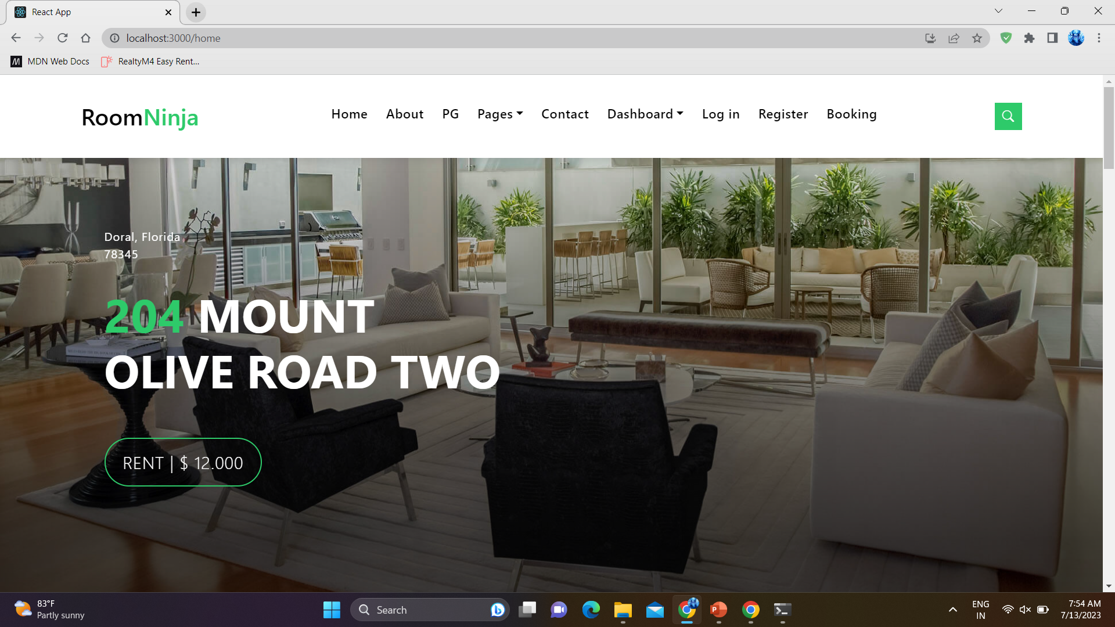
Screenshots

Slide 19
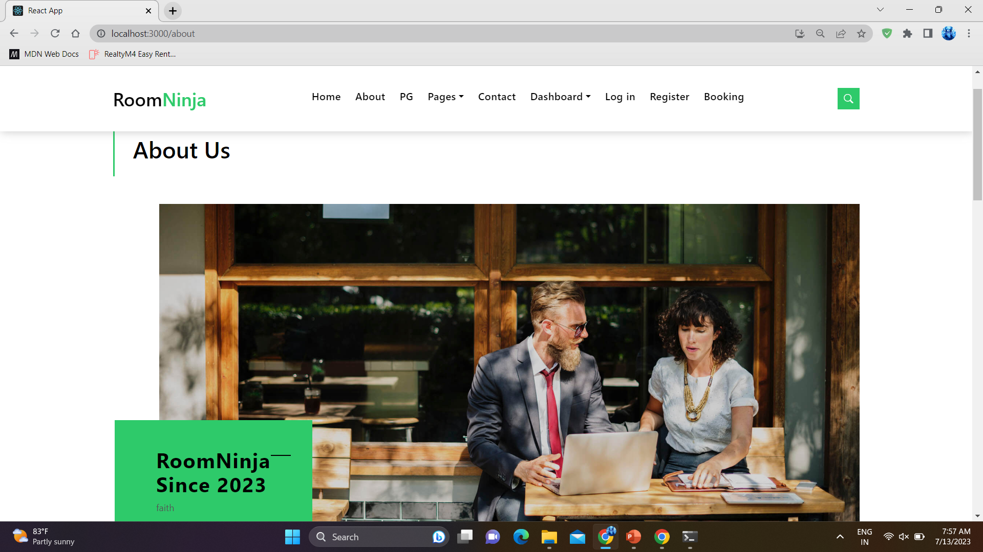
Screenshots

Slide 20
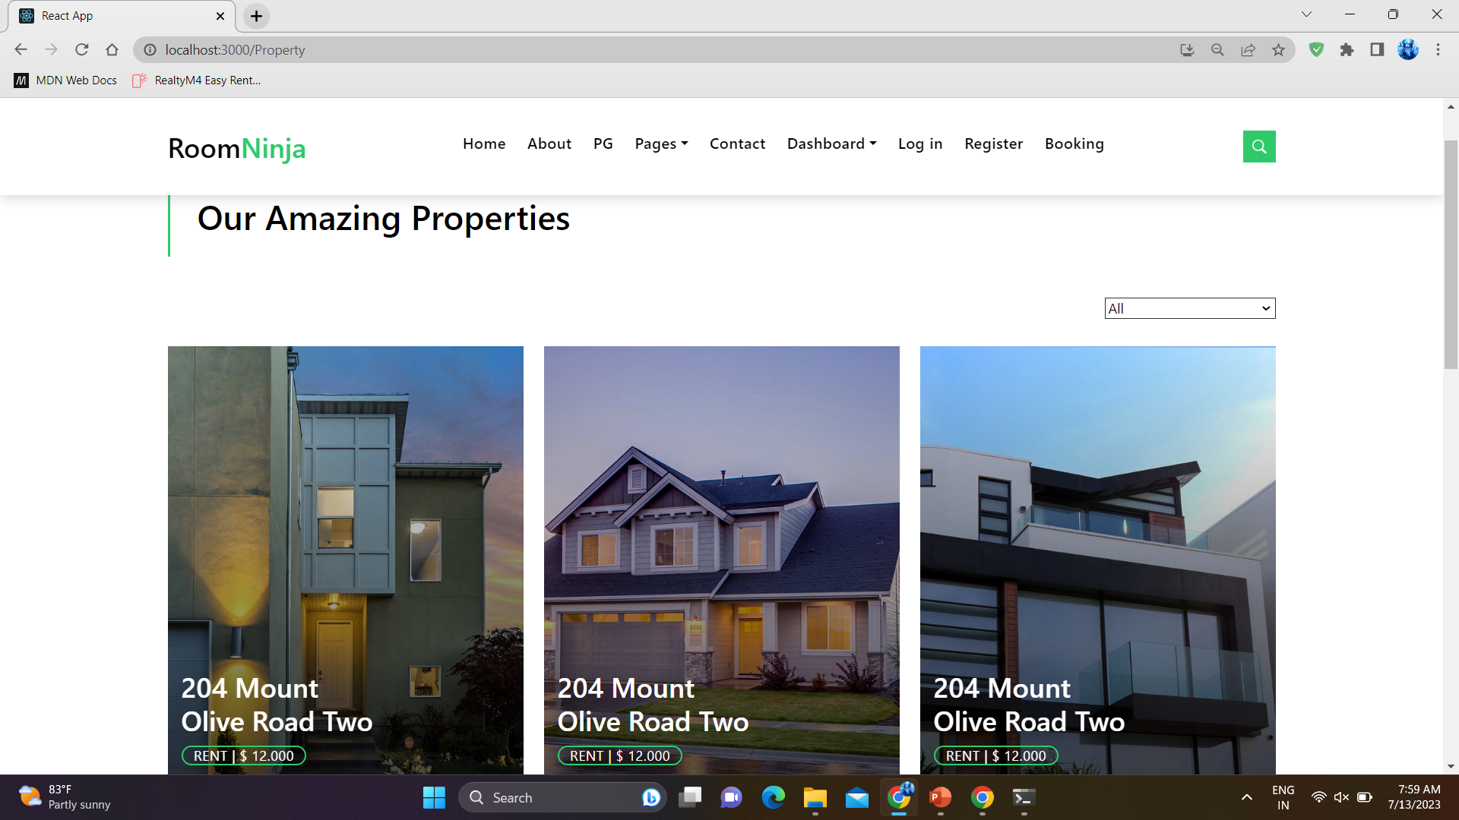
Screenshots

Slide 21
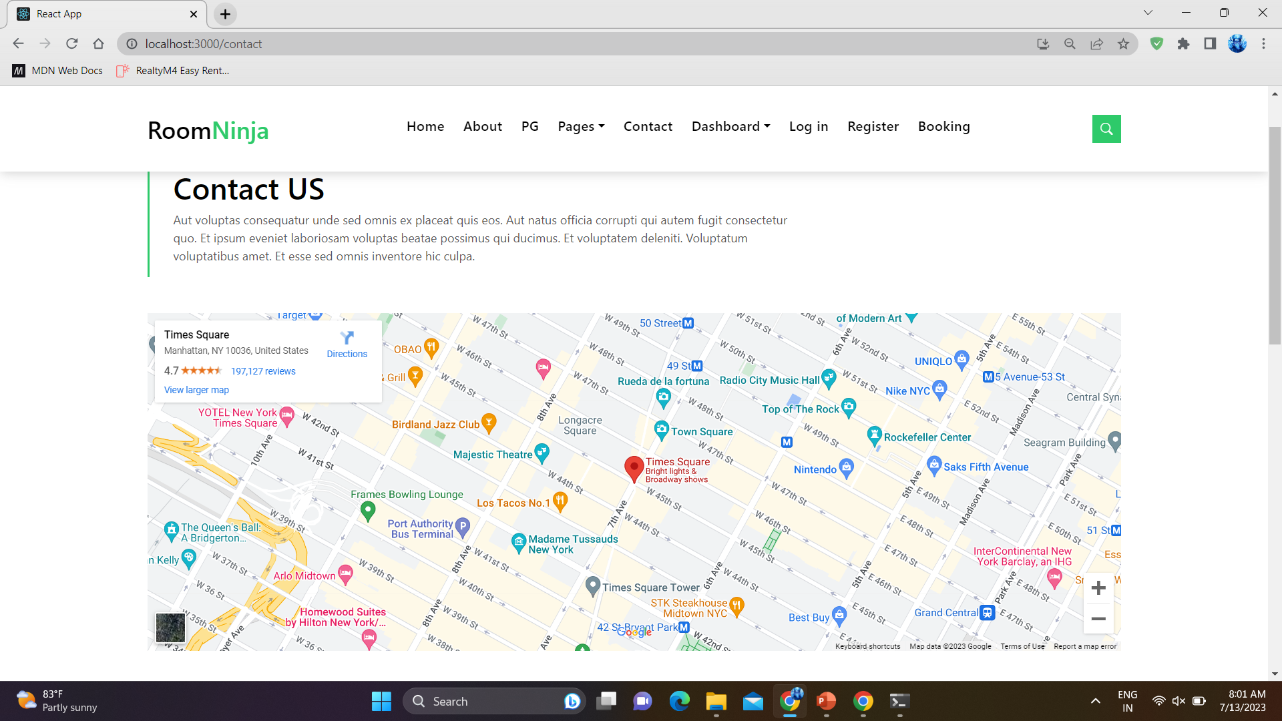
Screenshots

Slide 22
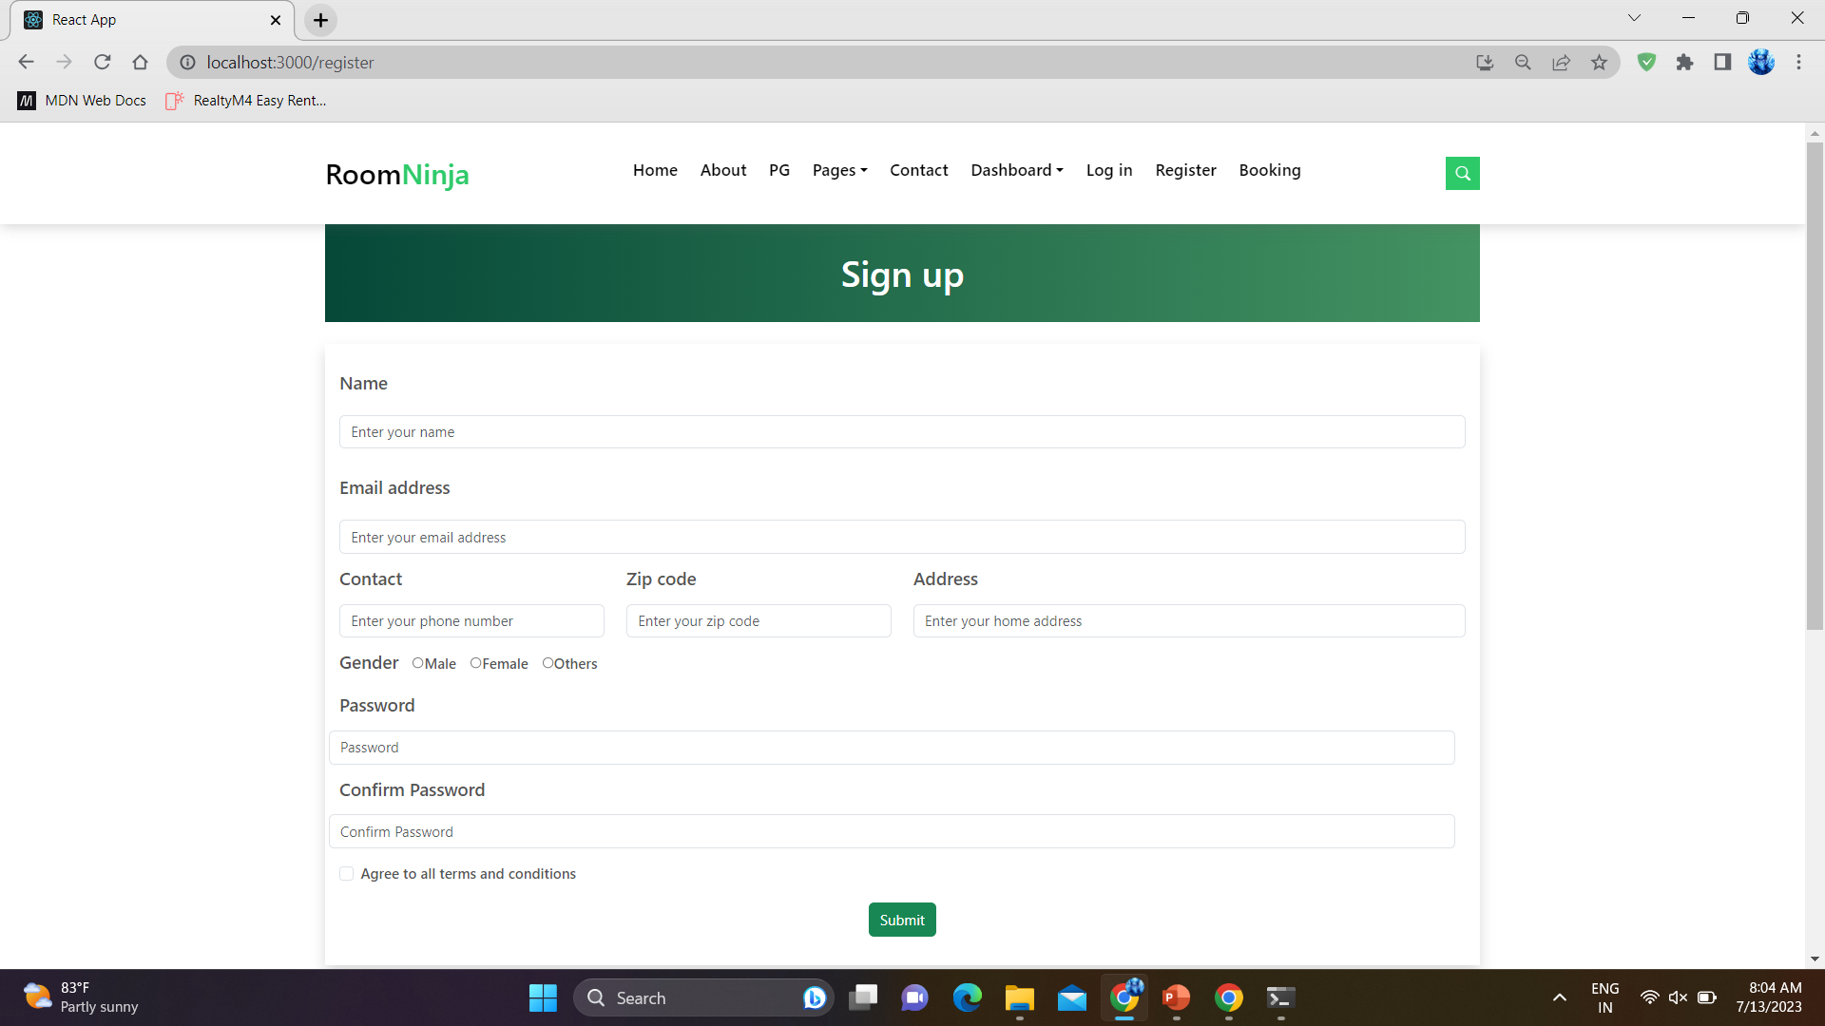
Screenshots

Slide 23
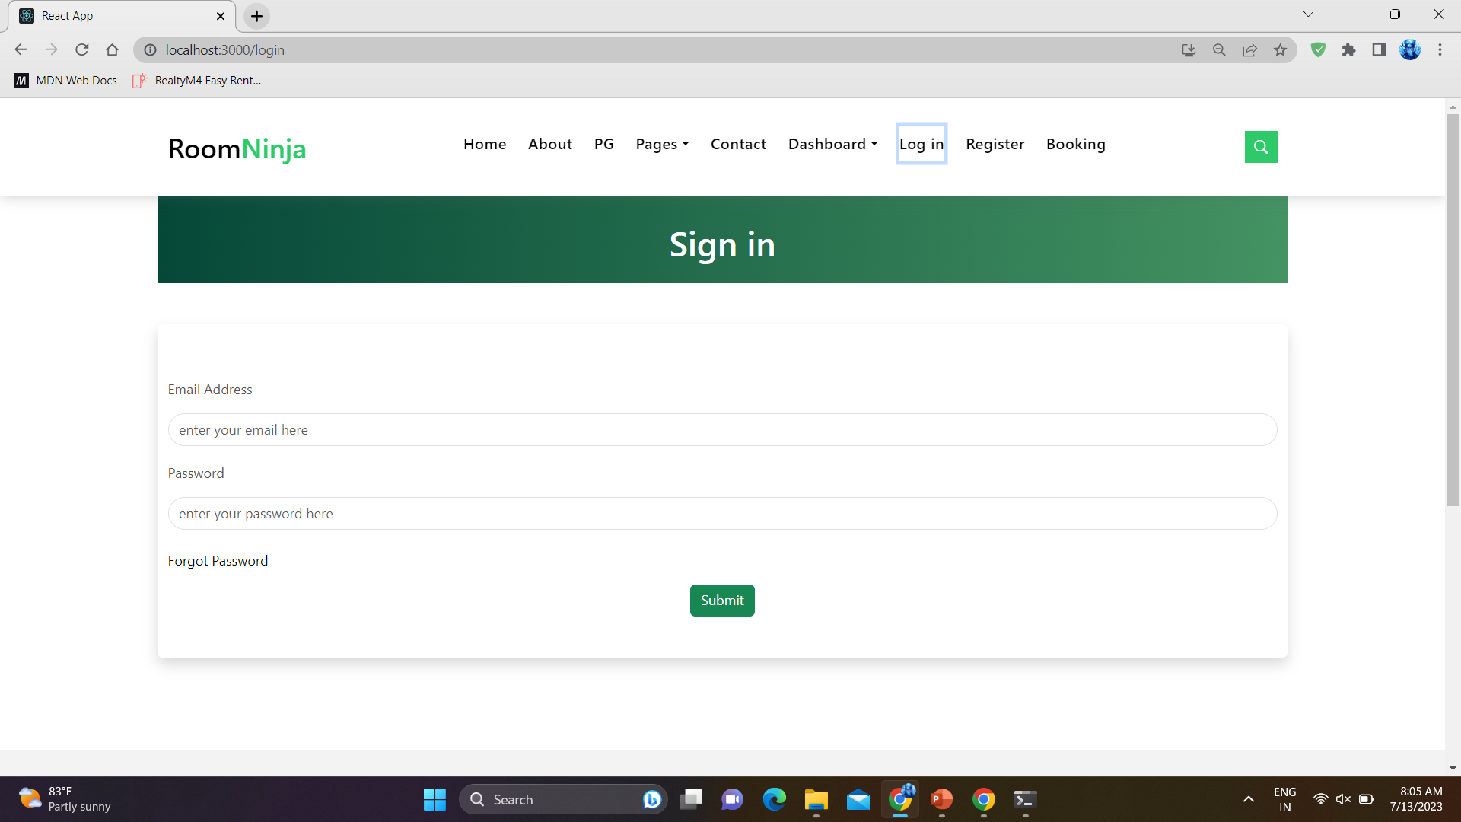
Screenshots

Slide 24
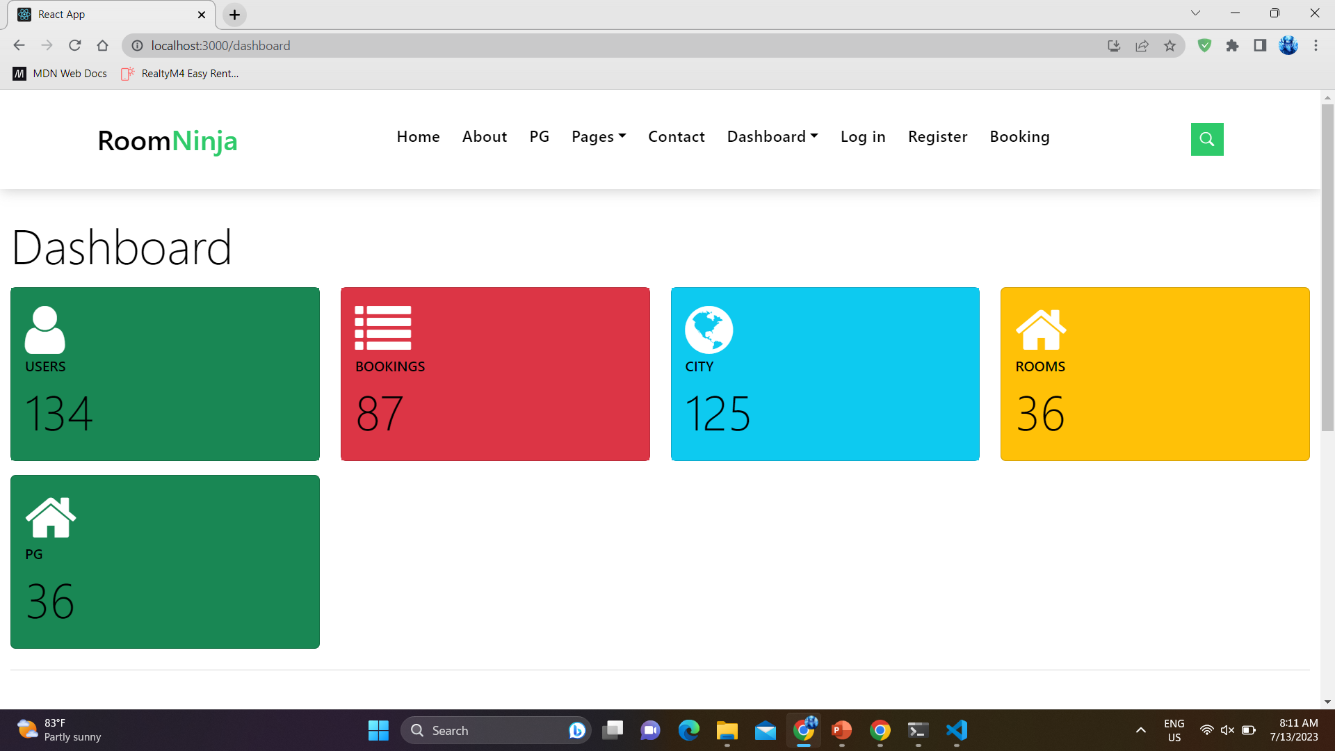
Screenshots

Slide 25
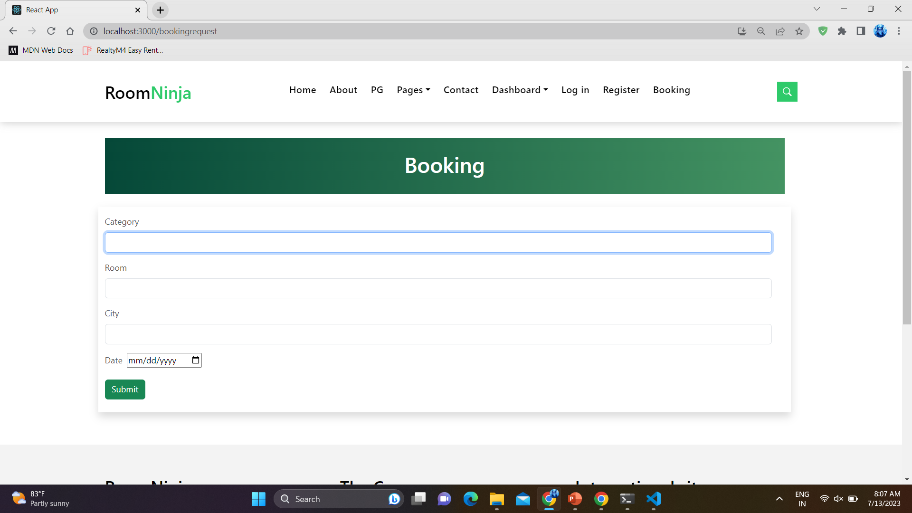
Screenshots

Slide 26
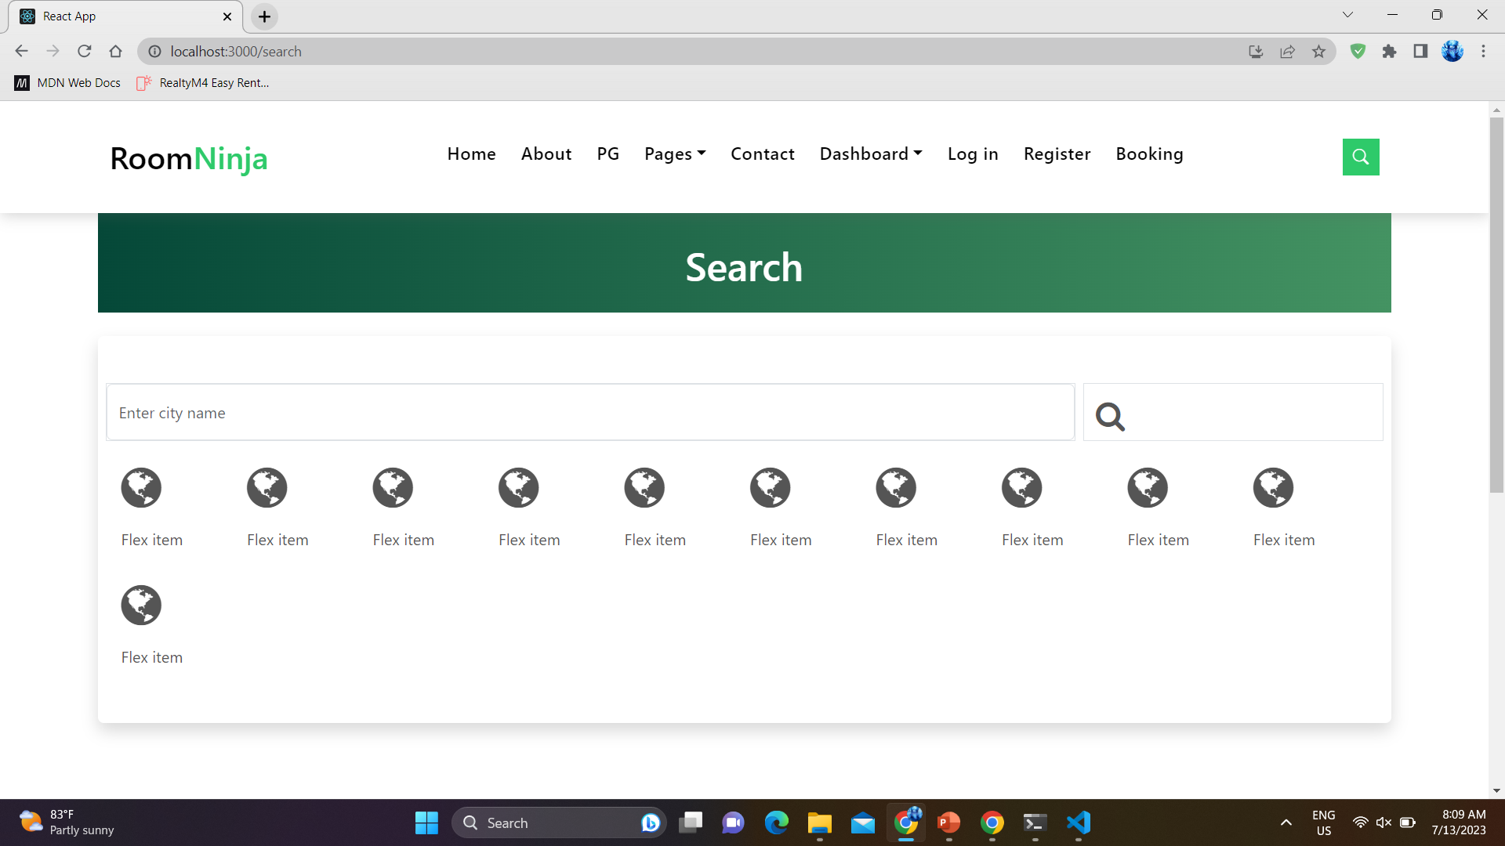
Screenshots

Slide 27
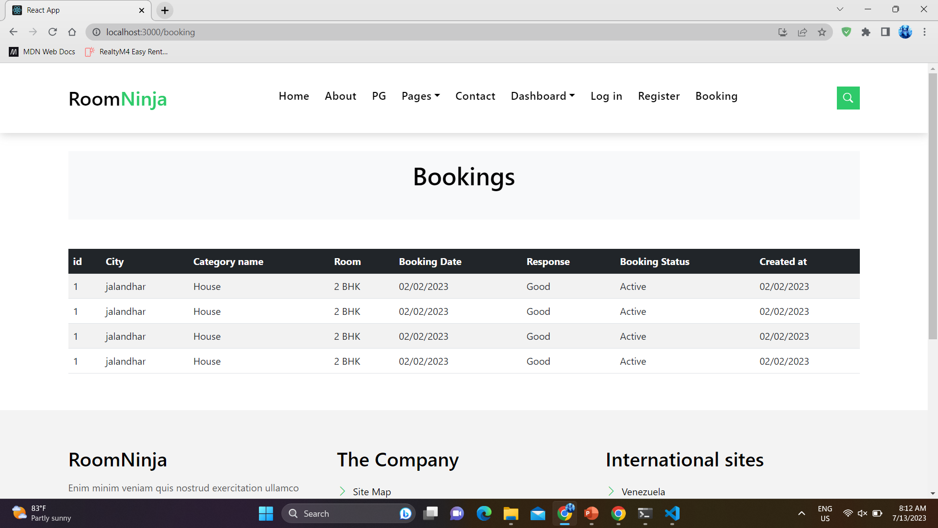
Screenshots

Slide 28
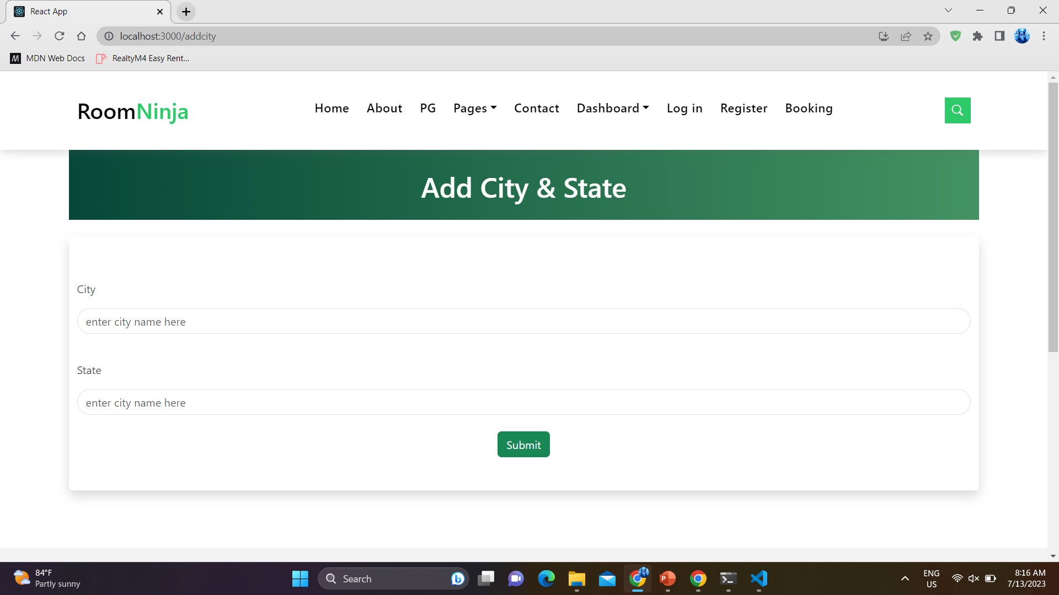
Screenshots

Slide 29
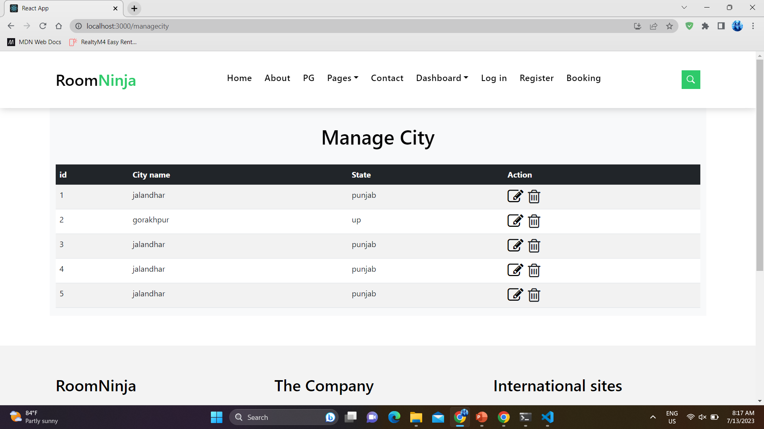
Screenshots

Slide 30
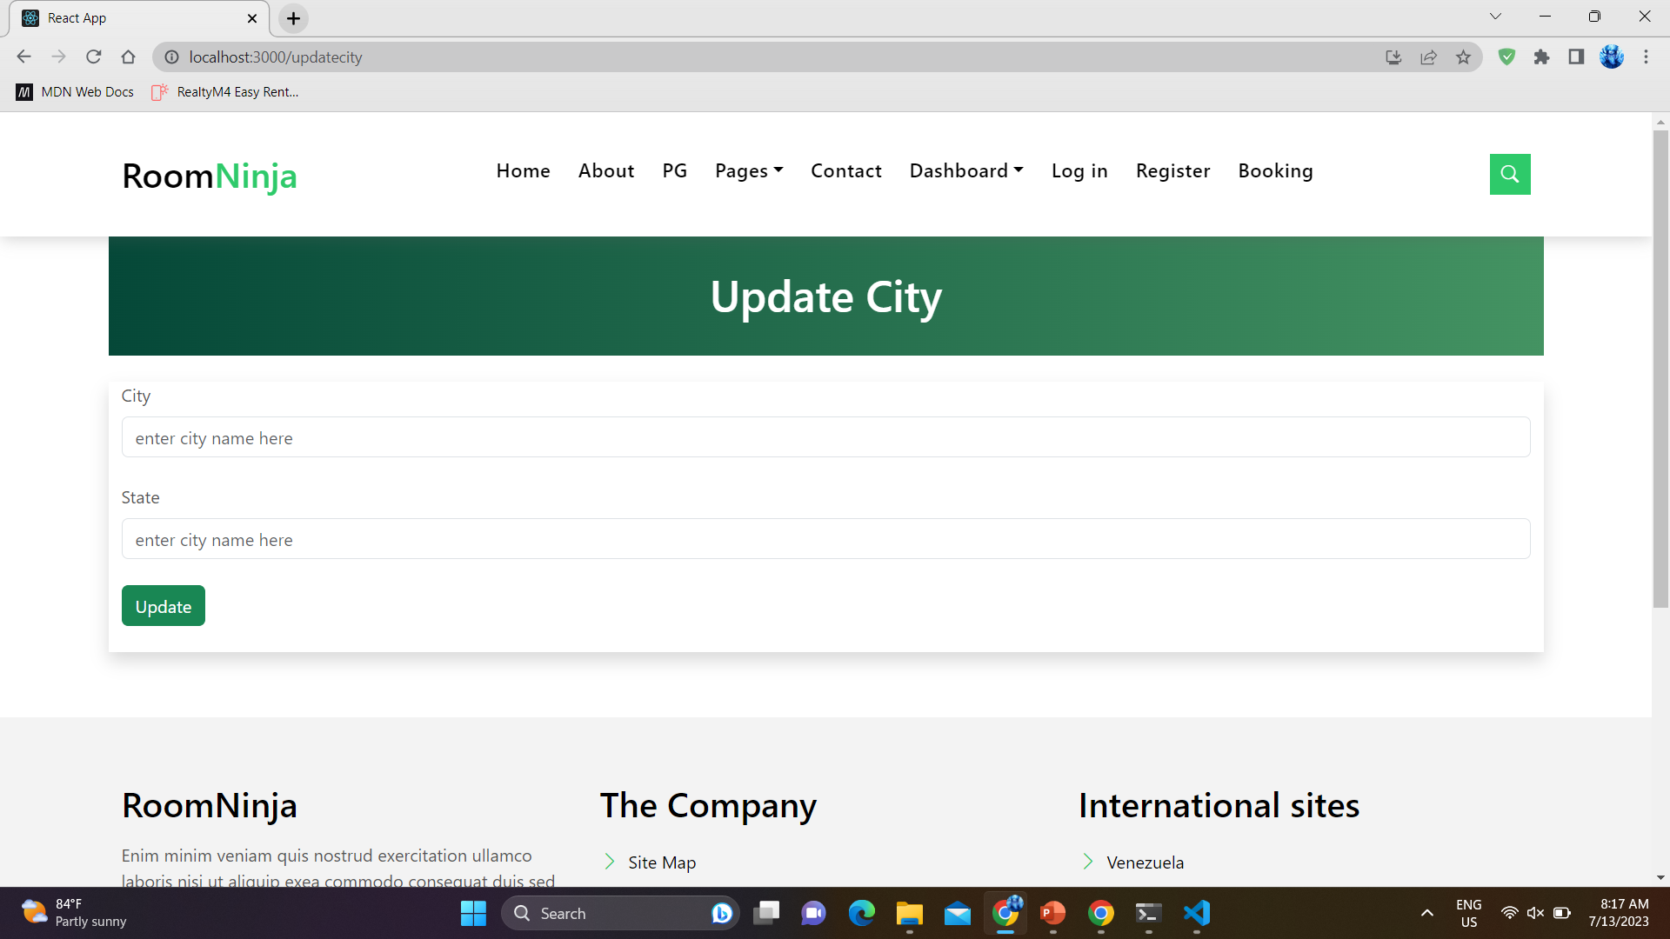
Screenshots

Slide 31
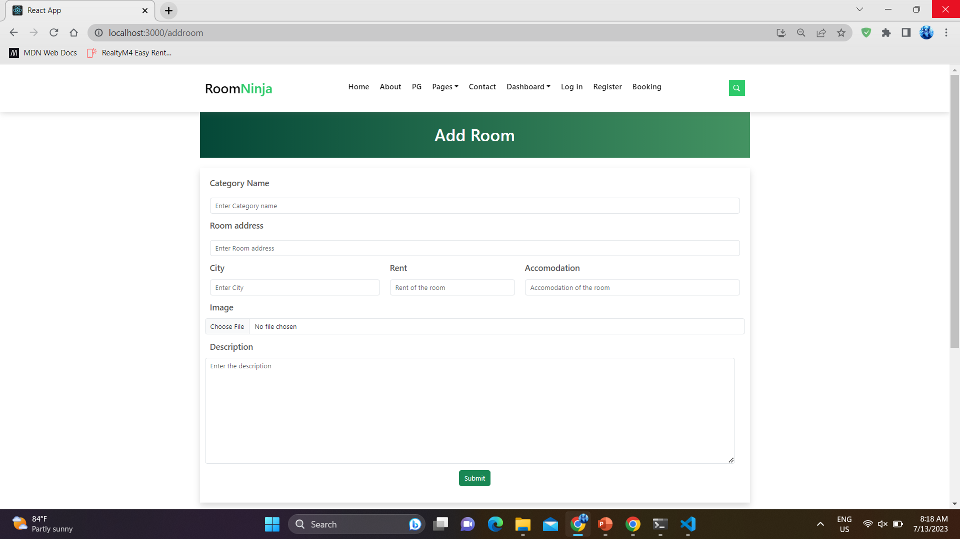
Screenshots

Slide 32
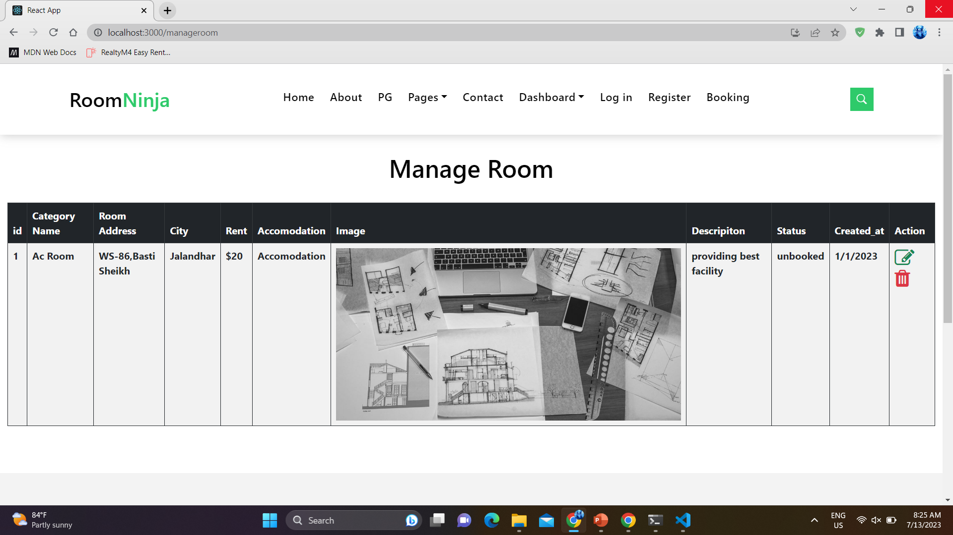
Screenshots

Slide 33
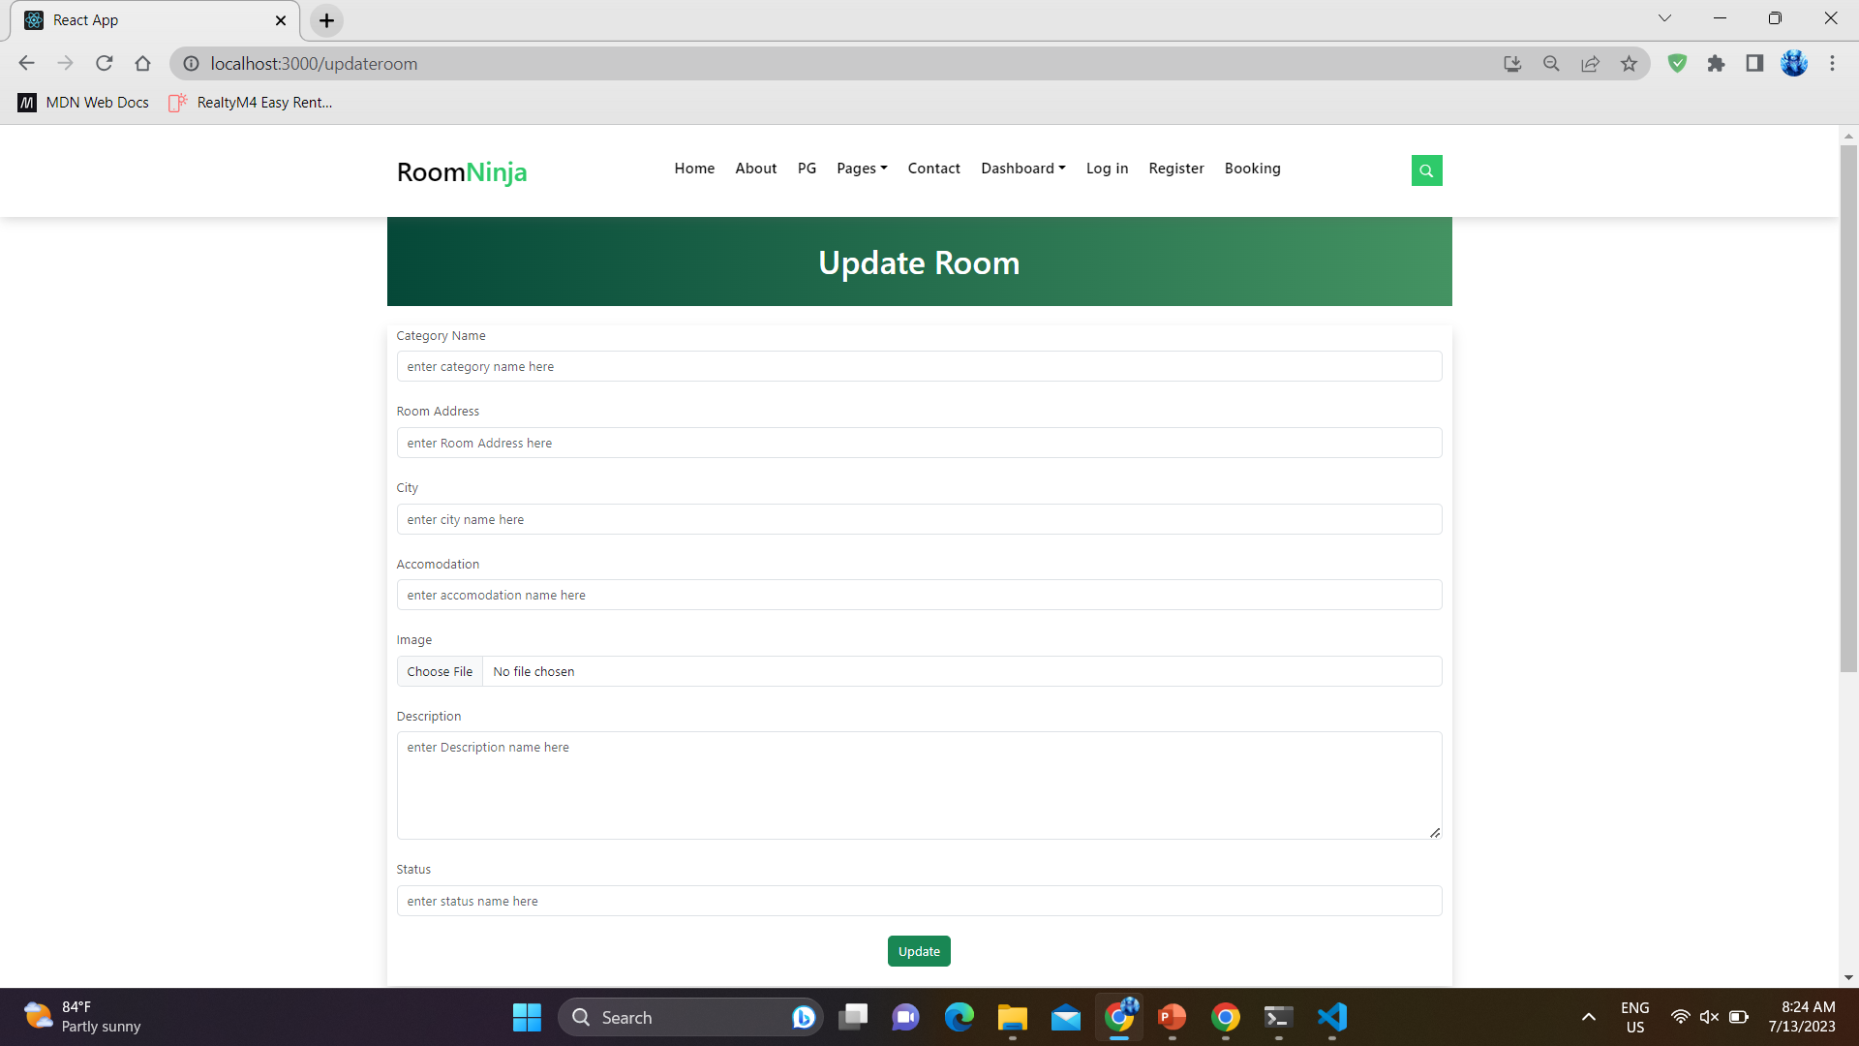
Screenshots

Slide 34
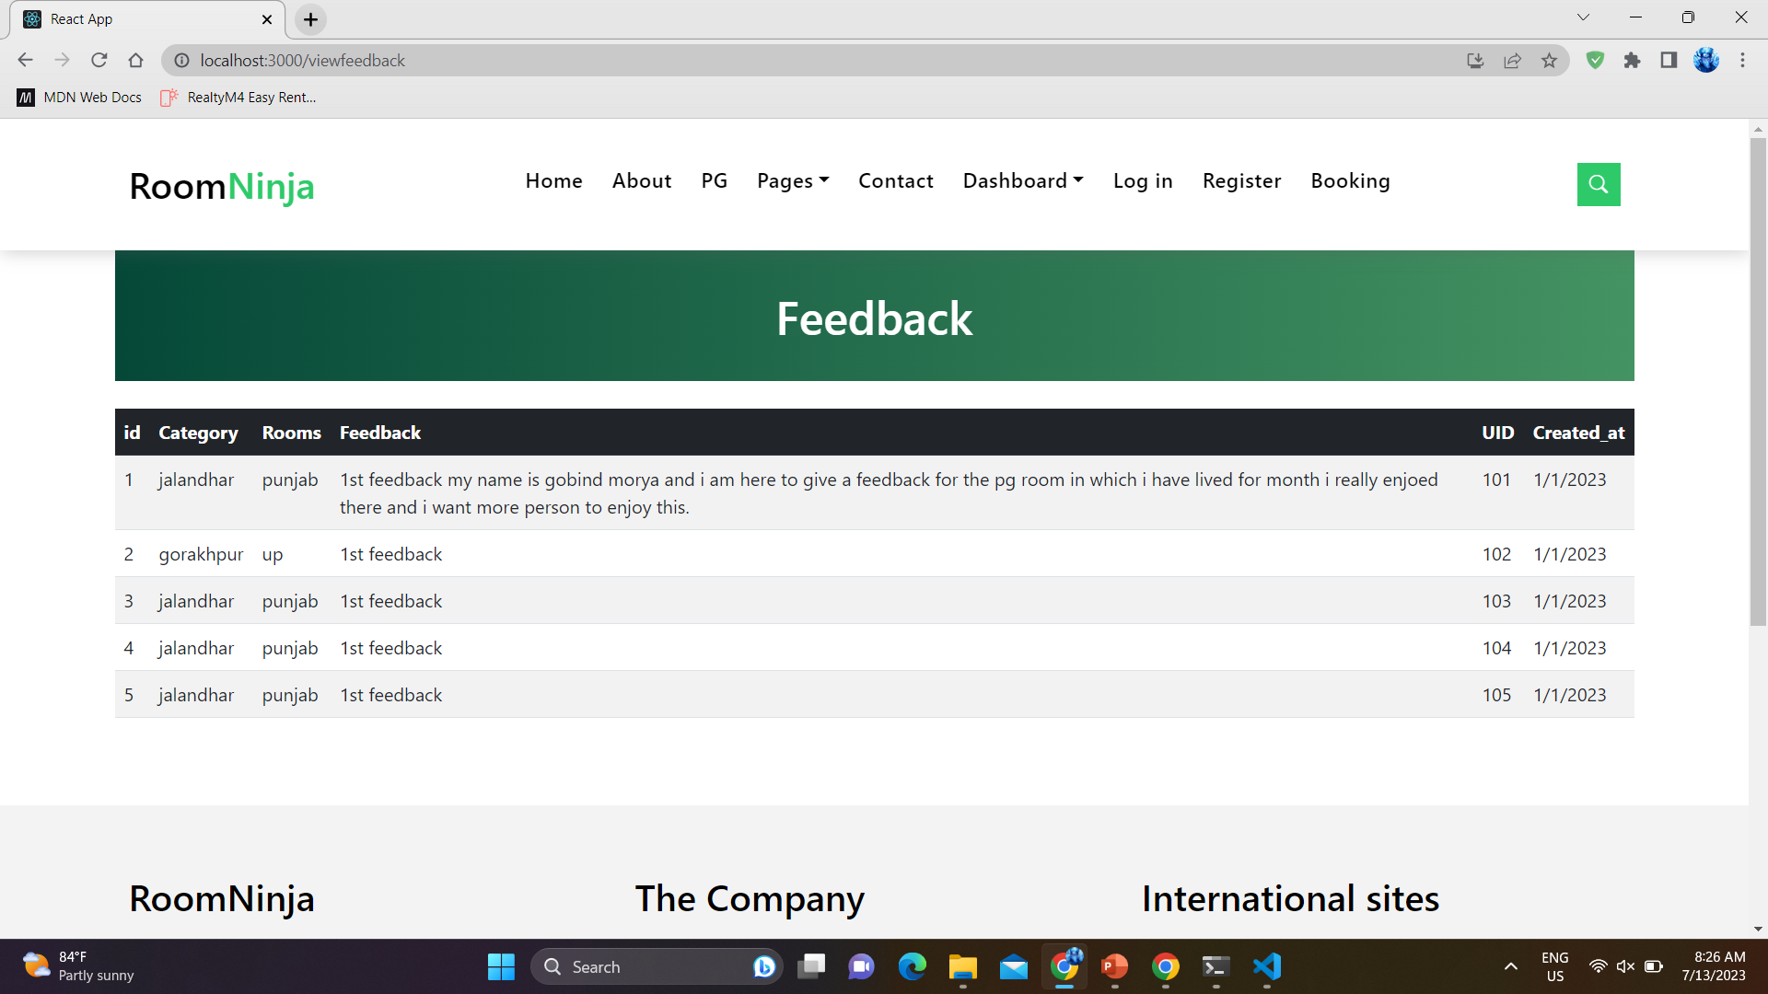
Screenshots

Slide 35
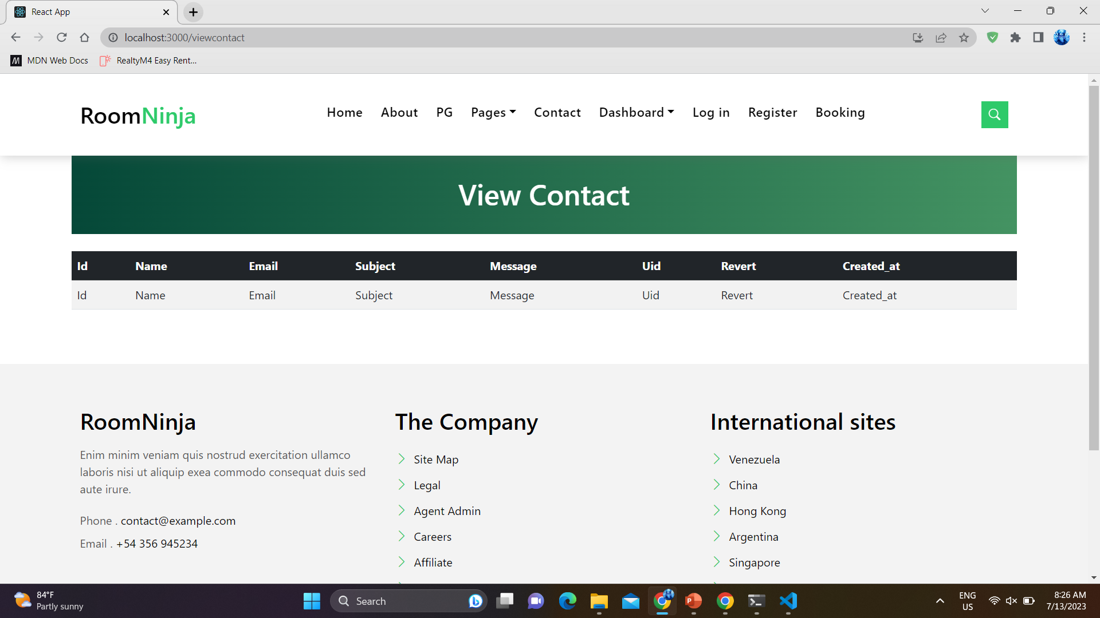
Screenshots

Slide 36

Conclusion
Dedicated web app improves user experience and overcomes limitations of existing systems.
Easy to use.
Verification processes and user reviews ensure trust and safety.
Interactive features empower users with scheduling visits, and seamless booking.
Advantages include cost-effective options and convenient amenities.
Proposed web app aims to provide a seamless and reliable platform for an improved PG search experience.

Slide 37

Future Work
Email verification can be added for authentication.
Adding payment gateway for providing online payment facility.

Slide 38


